Slide 1


Path traversal attack

Slide 2
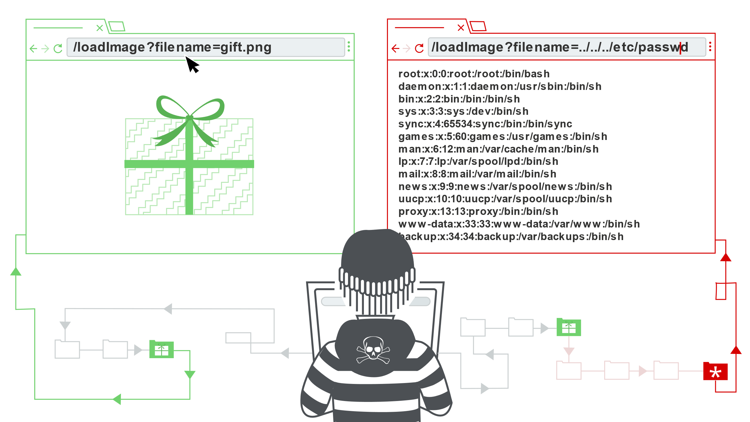
1. Overview
Path traversal is a type of vulnerability that allows an attacker to arbitrarily read arbitrary files on the server while the application is running.
By manipulating sequenced file reference variables like “dot-dot-slash (../)” or its variants, or by using absolute file paths an attacker can access to arbitrary files or directories stored on the system
In addition, this vulnerability is also known by other names such as: “dot-dot-slash”, “directory traversal”, “directory climbing” and “backtracking”.

Slide 3
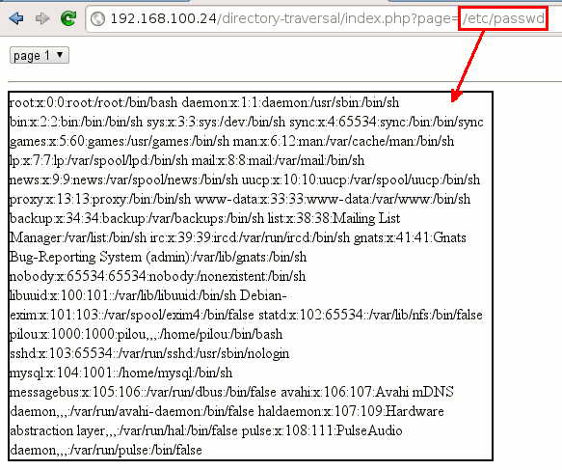
2. Impact
This is a serious vulnerability that can affect the server. Once the attacker has successfully attacked, they can read files in the web directory, or sensitive files stored inside the server.
Moreover, an attacker can write files to the system from where they can insert malicious code. The bad thing is that an attacker can do RCE

Slide 4
3. How to check path traversal?
B1: Pay attention to GET, POST, or COOKIE parameters that contain filenames or directories. Or any function that involves retrieving data from the server such as displaying images or displaying documents.
B2: Modify the parameter's value to insert an arbitrary subdirectory or a single traversal sequence. If the application’s behavior is identical in the two cases, it may be vulnerable.
VD: file=foo/file1.txt and file=foo/bar/../file1.txt
B3: If the application’s behavior is different in the two cases, it may be blocking, stripping, or sanitizing traversal sequences, resulting in an invalid file path. Examine whether there are any ways to circumvent the application’s validation filters.

Slide 5
B4: If the application function you are attacking provides read access to a file, attempt to access a known world-readable file on the operating system in question.
VD: Unix: ../../../../../../../../../../../../etc/passwd
Window: ../../../../../../../../../../../../windows/win.ini
B5: An alternative method for verifying a traversal flaw with write access is to try to write a new file within the web root of the web server and then attempt to retrieve this with a browser. However, this method may not work
if you do not know the location of the web root directory
if the user context in which the file access occurs does not have permission to write there.

Slide 6
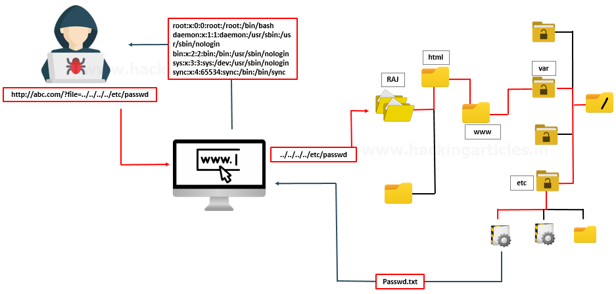
4. How does it work?

Slide 7
Let's say we initially have a web page, and the images are loaded via the following HTML:
<img src="/loadImage?filename=218.png">
This URL returns the contents of the specified file. To return the image, the application adds the requested filename to this base directory and uses the filesystem API to read the file's contents. In this case the file is read from the path:
“/var/www/images/218.png”
Since the application does not implement a defense against path traversal, an attacker can enter the following URL to retrieve arbitrary files from the server's file system:
“ https://insecure-website.com/loadImage?filename=../../../etc/passwd”
When loading this URL, the application will read from the file path:
“/var/www/images/../../../etc/passwd”

Slide 8
The string "../" is 1 string that is meant to go up 1 level in the directory structure. Three consecutive "../" strings read from the file's root system. Hence the file to be run will be: "/etc/passwd“
This file is a standard file containing the details of the signed user on the server with the UNIX operating system.
For Windows operating systems, both "../" and "..\" are accepted and similarly the standard OS file attack is:
“https://insecure-website.com/loadImage?filename=..\..\..\windows\win.ini”

Slide 9
5. How to bypass filter?
Many applications that put user input in file paths these days do some sort of defense against path traversal, and they can often be circumvented.
When the application's filter removes "../" we can use nested strings "....//", "....\/" which will have the same effect as “.. /”
You can simply URL encode the characters "." or "/". If not, you can use non-standard encoding types "..%c0%af", "..%252f“
16-bit Unicode encoding: Dot: “%u002e”, Forward slash: “%u2215”, Backslash: “%u2216”
Double URL encoding: Dot: “%252e”, Forward slash: “%252f”, Backslash: “%255”
UTF-8 Unicode encoding: Dot: “%c0%2e”, “%e0%40%ae”, “%c0ae”, Forward slash: “%c0%af”, “%e0%80%af”, “%c0%2f”, Backslash: “%c0%5c”, “%c0%80%5”

Slide 10
The second type of input filter commonly encountered involves verifying whether a user-supplied filename contains the suffix (file type), or prefix (start directory) expected by the application.
Some applications check if a user-supplied filename ends in a specific file type or set of file types and reject attempts to access anything else. We can get around this by using the null URL encoded byte (%00), then we'll have an approved filename.(PHP, DOS.net, Java)
VD: .. /.. /.. /etc/passwd%00.jpg
Some applications check if a user-supplied filename begins with a specific sub-direction of the starting directory, or even a specific filename. If an application requires a user-supplied filename to begin with the expected base directory, the required base directory can be included followed by the appropriate traversal strings.
VD: filename=/var/www/images/../../../etc/passwd
We can combine many ways together to get through the easiest way.

Slide 11
6. Prevent
Ways to effectively protect against a Path Traversal attack are:
The safest way to prevent is to not pass user input completely into the system API
If the pass in is absolutely required, then we need to strictly control the user input only for the characters [0-9a-zA-z]
Use normalization libraries when using user input to manipulate files
Upgrade the system to the latest as many systems today update libraries that can resist path traversal attacks

Slide 12
7. Reference
VK9 Security: https://vk9-sec.com/basics-of-path-traversal/
PortSwigger: https://portswigger.net/web-security/file-path-traversal
Acunetix: https://www.acunetix.com/websitesecurity/directory-traversal/
Owasp: https://owasp.org/www-community/attacks/Path_Traversal
Netsparker: https://www.netsparker.com/blog/web-security/directory-path-traversal-attacks/

Slide 13


